Slide 1
WeSolve
a learning community
Nir Swartz
Guy Shnaider
Ido Gazit
Itai Weiss

Slide 2
The Main Idea
WeSolve is a platform for sharing and ranking solutions for university exams.
Our goal is to create a learning community and help students to study better and pass the exams successfully.
Students can register to WeSolve, upload solutions to questions from past exams, and watch other students’ solutions to the same question.
In addition, students can contribute to the WeSolve community by labeling questions and ranking solutions, in order to improve the studying experience in the website and make it more accurate and efficient.

Slide 3
Why we chose this idea
As university students during COVID-19, creating study groups for exams became more difficult since students were not physically in the campus, so making new connections with other students was hard.
WeSolve intends to fill this gap and make the studying experience a little bit more social and cooperative.
We liked this idea since a platform like this is vital, and we think that only contribution from the students (the crowd) will make a better platform.

Slide 4
Crowdsourcing notions @ WeSolve
Ranking Solutions
Uploading Solutions
Labeling Questions
Questions Similarity
Upvote
Downvote
Topic
Difficulty
Importance
Points percentage
Multichoice or open
Similar
Not Similar
Scanned solution
Free text

Slide 5
Features @ WeSolve
Students can upload their solutions for exams.
Students can label exam questions from previous years.
Students can rank other students’ solutions.
For each question, students can see the best solutions according to the students’ ranking.
For each question, students can see similar questions according to the students’ labeling.
In each course, students can see which are the most important question to solve before the exam according to the students’ labeling.

Slide 6
Optional features @ WeSolve
For each solution, students can label the similarity to other solutions for the same question.
In each course, there will be a contest to provide solutions for “hot questions”.
Teachers can rank other students’ solutions, and this ranking will have a greater influence.
In each course, there will be a recommended studying plan by topic according to the students’ labeling.

Slide 7
Challenges
Find the most influencing labels for the recommendation engine.
Identify the best solutions for each questions.
Detect similar questions.
Detect similar solutions.
Detect opposing solutions.

Slide 8
Obstacles
Motivation: We need to make sure that enough data is provided by the students (the crowd. In order to do so, we’ll request students to upload solutions and/or rate some number of random solutions to grant them access of all solutions in our site.
Quality of Solutions: We need to motivate high quality solutions. So students that uploaded high rated solutions will receive a rank and will be given awards (gamification). Each user will have a ranking, a higher rank will give more possibilities in the website.
Spammers: Student can contribute non-valuable data just to use the website, so we need to detect and block non relevant data. We’ll allow students to report spam solutions. Low ranked users have higher risk to be spammers.

Slide 9
Assumptions
Exams and all the administrative data about the courses are provided by the university.
In general, labels and grades given by the crowd will be reliable.
The site will be designed based on TAU, but can be adjusted to other institutes.

Slide 10
Technology & Architecture
^{Platform - Website}
^{Backend - Python, Django}
Frontend - HTML, CSS, JavaScript (Vue.js)
^{Database - MySQL}

Slide 11
Workplan
Backend - Guy Shnaider & Itai Weiss
Frontend - Ido Gazit & Nir Swartz

Slide 12
Portfolio samples

Slide 13
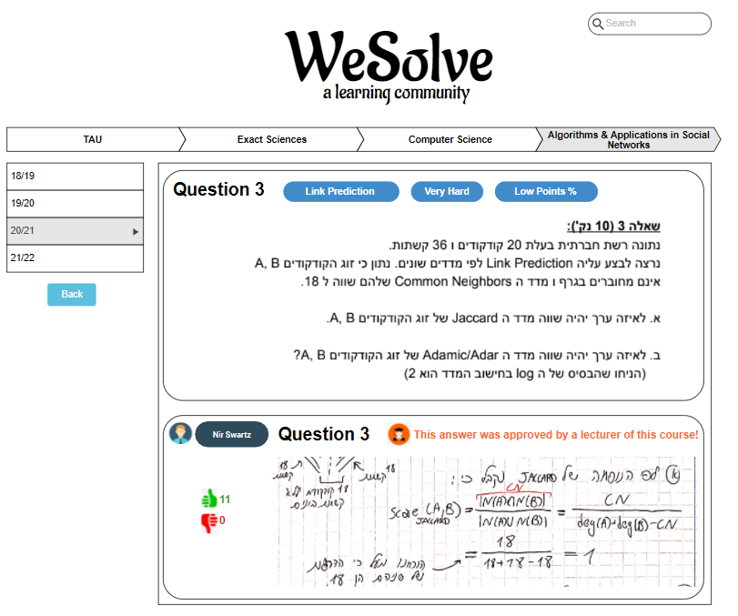
Question Page

Slide 14
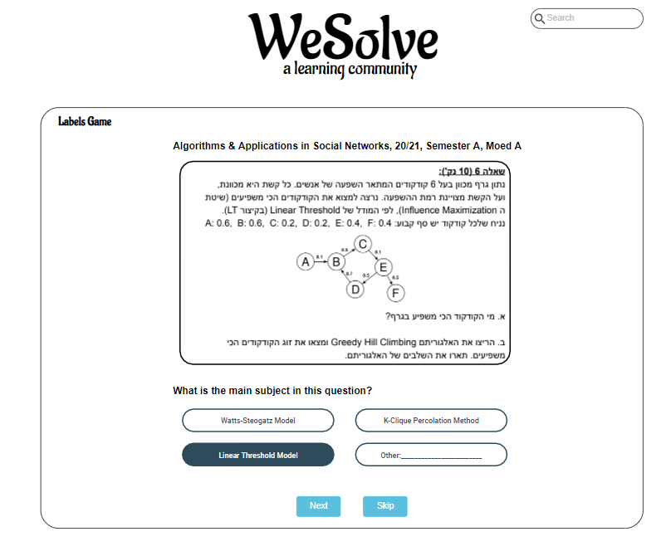
Labels Game

Slide 15
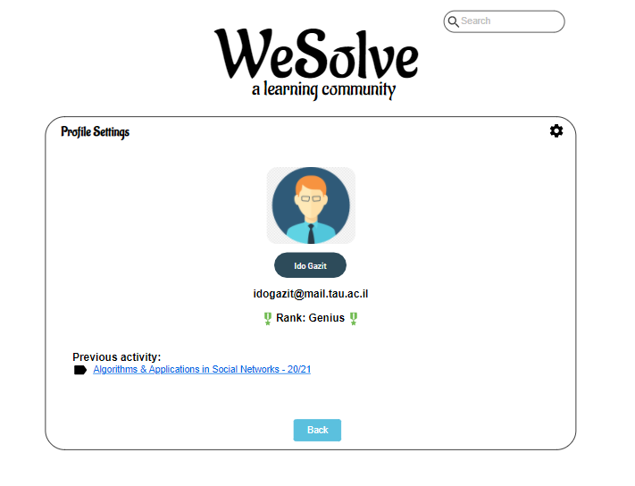
Profile Settings

Slide 16


Thank you!

